Slide 1
Layering
layering means to break up the sending of messages into separate components and activities. Each component handles a different part of the communication.
This can be referred to as the Transmission Control Protocol/Internet Protocol (TCP/IP) model.

Slide 2
TCP/IP TCP Stands For Transmission Control Protocol. IP Stands For Internet Protocol
The Main Use of the TCP/IP is a Network Model Designed to support Network Communication, Even if the Computer Are from the different manufactures pc’s .
TCP/IP is a Practical Model Developed to meet the Needs of the Original Internet design. TCP/IP are the set of Two Protocols it consist of Numerous Protocols at different Layers.
The TCP/IP model consists of four layers: the application layer, transport layer, network layer and physical layer.

Slide 3
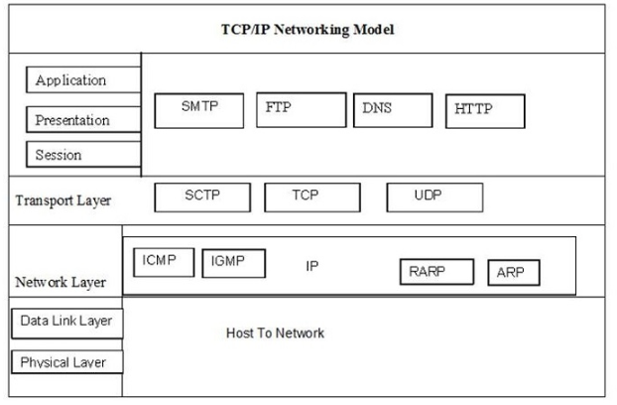
Functions of TCP/IP layers

Slide 5
Application layer
In TCP/IP, the Application layer protocols provide services to the application software running on a computer. The application layer uses HTTP,FTP, and SMTP protocols. The application layer provides an interface between the software running on a computer and the network itself.
FTP (File Transfer Protocol)
It is one of the widely used application layer protocol of the TCP/IP protocol suite. FTP is basically used to exchange data between two host devices over the Internet securely.
It is referred to as one of the safest modes of file sharing among systems, and thus it is deployed by large industries, universities, and offices.

Slide 6
SMTP (Simple Mail Transfer Protocol)
SMTP is the standardization for transmission of electronic mails on the Internet.
It is used by the e-mail server for sending and receiving messages, but the client host-based application only uses it for sending messages to the mail server.
For receiving purposes, they use POP3 or IMAP.

Slide 7
DNS (Domain Name Server)
DNS is a directory service that provides a mapping between the name of a host on the network and its numerical address. DNS is required for the functioning of the internet
HTTP
HTTP stands for Hypertext Transfer Protocol. It is an application protocol
Hypertext Transfer Protocol (HTTP) is a method for encoding and transporting information between a client (such as a web browser) and a web server. HTTP is the primary protocol for transmission of information across the Internet.

Slide 8
THE TRANSPORT LAYER
It is responsible for maintaining the communication between the sender and receiver. TCP or UDP (User Datagram Protocol) is used for this purpose.
At the sending node, the transport layer receives the message from the application layer. When the message reaches the transport layer, one of the transport layer protocols, i.e., TCP or UDP, is selected.
TCP supports segmentation. So, if the message is large, TCP divides it into smaller pieces and adds a header to form a TCP segment.
On the other hand, UDP does not support segmentation, so the applications using UDP should send messages short enough to fit into one UDP datagram.

Slide 9
THE NETWORK LAYER
The network layer is responsible for creating a connection between the source computer and the destination computer. The communication at the network layer is host-to-host. However, since there can be several routers from the source to the destination, the routers in the path are responsible for choosing the best route for each packet. :
Logical Addressing
Routing

Slide 10
Logical Addressing
Every computer in a network has a unique IP address. The network layer assigns sender and receiver’s IP addresses to each segment or datagram to form an IP Packet. IP addresses are assigned to ensure that each IP packet can reach the correct destination present in different networks.
Routing
Routing is a method of moving an IP packet from source to destination present in different networks. Routing is not needed if the source and destination computers are present in the same network.
For communications within a network, the task is usually simple. module takes the destination IP address from the IP packet and returns the MAC address of the destination computer. It is then used to create an Ethernet frame which is delivered directly to the destination as it is present in the same network, . no routing is needed.

Slide 11
Physical layer
the physical layer is responsible for carrying individual bits in a frame across the link. Although the physical layer is the lowest level in the TCPIIP protocol suite, the communication between two devices at the physical layer is still a logical communication because there is another, hidden layer, the transmission media, under the physical layer.
Two devices are connected by a transmission medium (cable or air). We need to know that the transmission medium does not carry bits; it carries electrical or optical signals.

Slide 12
Advantages
It is used in many varieties of fields even after three to four decades after its introduction.
It helps to communicate between heterogeneous networks (i.e., networks with many differences like that in protocols, etc.)
It follows a client-server architecture. Therefore, more devices can be added or removed easily because of its scalability.

Slide 13
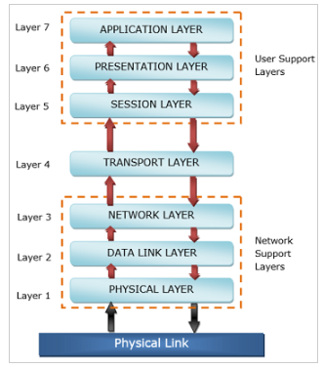
OSI Reference Model
OSI stands for Open Systems Interconnection Created by International Standards Organization (ISO).
This layered model is a conceptualized view of how one system should communicate with the other, using various protocols defined in each layer. Further, each layer is designated to a well-defined part of communication system.

Slide 14
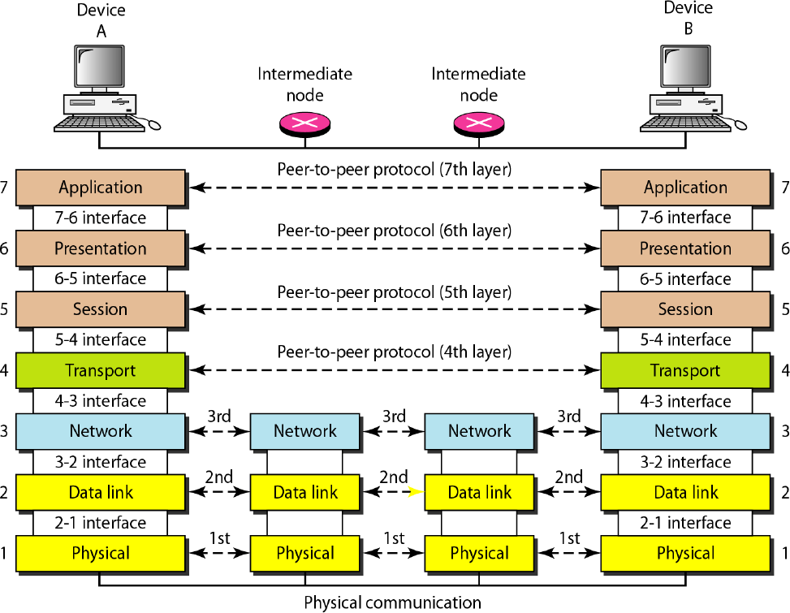
The Interaction between layers in the OSI model

Slide 15
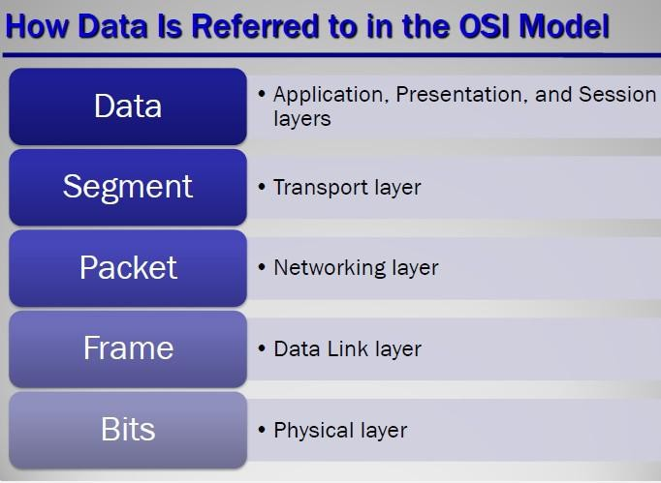
1. Physical Layer
The Physical Layer is the lowermost layer in the OSI model and its major responsibility includes the actual propagation of the unstructured data bits (0’s and 1’s) across the network, from the physical layer of the sending device to the physical layer of the receiving device.
The Physical layer contains information in the form of bits. It transmits individual bits from one node to the next node. The transmission media defined by the physical layer include metallic cable, optical fiber, and the wireless radio-wave.

Slide 16
2. Data-Link Layer
It is the second layer of the OSI model. The data link layer is responsible for providing error-free communication across the physical link connecting the primary and secondary nodes within a network.
Functions of the Data-link layer
Framing: The data link layer translates the physical's raw bit stream into packets known as Frames. The Data link layer adds the header and trailer to the frame. The header which is added to the frame contains the hardware destination and source address.

Slide 17
Error handling − It is used to soles the damaged, lost, and duplicate frames.
Flow Control − It keeps a fast transmitter from flooding a slow receiver.
Access Control − In access control, if many hosts have usage of the medium, When a single communication channel is shared by multiple devices, the MAC sub-layer of data link layer helps to determine which device has control over the channel at a given time.

Slide 18
3. Network Layer
The network layer provides details that enable data to be routed between devices in an environment using multiple networks, sub-networks, or both.
The networking components that operate at the network layer include routers and their software. It determines which network configuration is most appropriate for the function provided by the network and addresses and routes data within a network by establishing, maintaining, and terminating connectors between them.
It provides the upper layers of the hierarchy with independence from the data transmission and switching technologies used to interconnect systems.

Slide 19
4. Transport Layer
We can say that the transport layer controls and ensures the end-to-end integrity of the data message propagated through the network between two devices, providing the reliable, transparent transfer of data between the endpoints.
Segmentation and Reassembly − In this, a message is divided into small pieces. Reassemble the message correctly upon arriving at the destination.
Reliability − It ensures that packets arrive at their destination. Reassembles out-of-order messages.
Service Decisions − It is used to check what types of service to provide error-free point-to-point, datagram, etc.
Mapping − It determines which messages belong to which connections.
Naming − It must be translated into an internal address and route, send to node XYZ.
Flow Control − It keeps a fast transmitter from flooding a slow receiver.
Error Control − To retransmit the damaged segments.

Slide 20
5. Session Layer
The session layer creates communication channels between devices. It is responsible for opening sessions, ensuring they remain open and functional while the data is being transferred, and close the session when the communication ends.
The session layer can also set checkpoints during a data transfer. If a session is interrupted, then the devices can resume data transfer from the last checkpoint.

Slide 21
Session Layer Responsibilities −
Network log-on and log-off procedures
User authentication
Determines the type dialog available − simplex, half-duplex, and full-duplex.
Synchronization of data flow for recovery purposes.
Creation of dialog units and activity units.

Slide 22
6. Presentation Layer
The presentation layer prepares the data for its upper layer or the application layer. It defines how two devices should encode, encrypt, and compress the data.
The presentation layer receives any data transmitted by the application layer and prepares it for transmission over the session layer.
It specifies how the end-user applications should format the data.
This layer provides for the translation between the local representation of data and the representation of data that will be used for transfer between the end-users.

Slide 23
7. Application Layer
The application layer is the topmost layer in the OSI model and acts as the general manager of the network by proving access to the OSI environment. This layer provides distributed information services and controls the sequence of activities within an application and also the sequence of events between the computer application and the user of the application.
The application layer uses HTTP, FTP, POP, SMTP, and DNS protocols that allow the software to send and receive information and present meaningful data to users.

